Slide 1
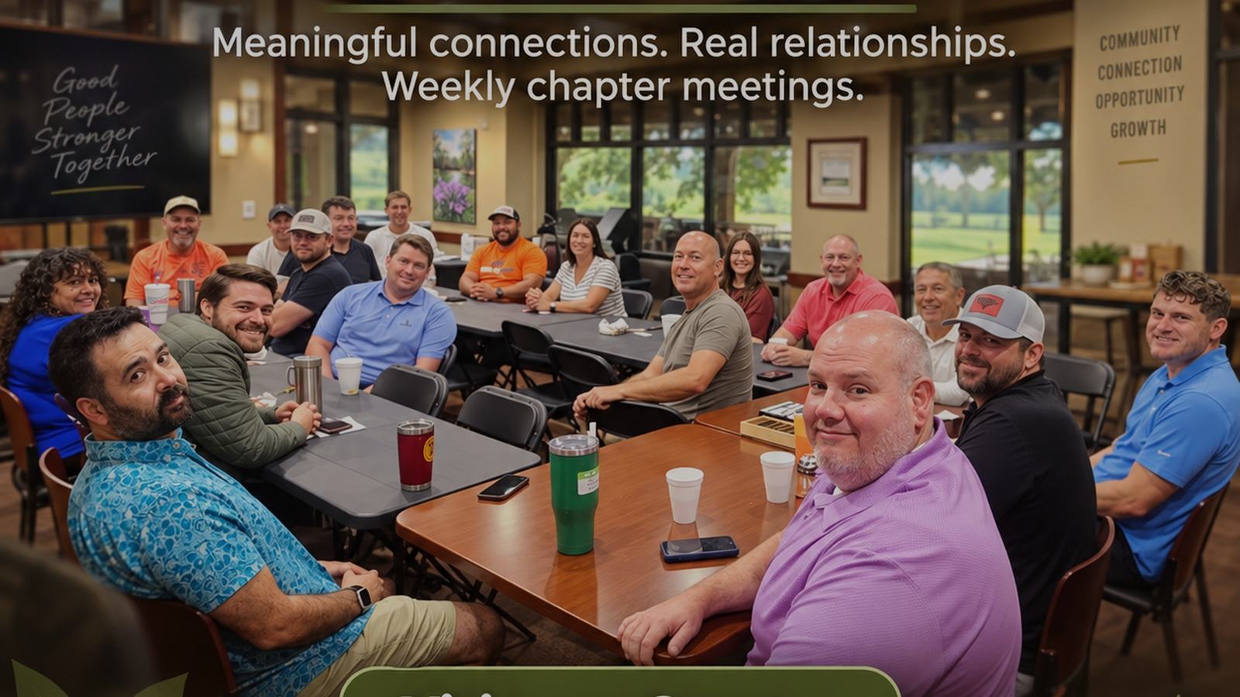
THERE’S A SEAT AT THE TABLE
Paid Social Campaign Proposal
Inspiring New Growth • $100/month pilot • Facebook + Instagram
Prepared September 2026

Slide 2
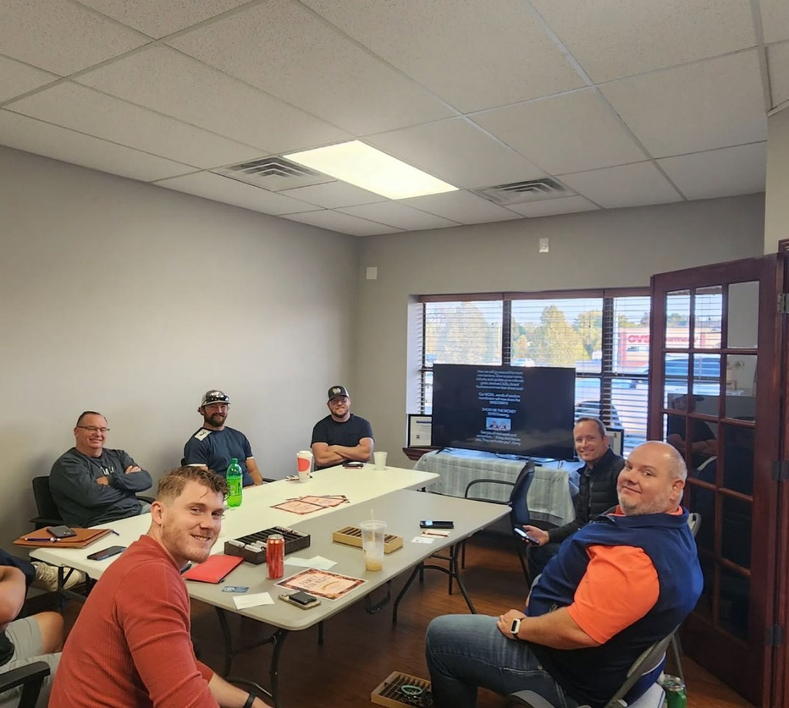
THE BIG IDEA
We are not advertising a membership.
We are advertising an invitation.
One simple ask:
Come sit with us.
ING • There’s a Seat at the Table • Proposal

Slide 3
MEDIA RECOMMENDATION
Put the entire $100 into Meta.
Facebook + Instagram give us the best shot at efficient local reach with a very small budget.
$100 / MONTH
ONE ACTIVE MARKET
ONE ACTION
$3.33 per day.
Enough for a focused local test—not enough for eight tiny campaigns.
One chapter cluster at a time so the budget can actually learn and deliver.
Drive to the campaign page and optimize for landing-page views: “Visit as a Guest.”
Why Meta?
Meta currently supports local geographic targeting plus demographic, interest and behavior targeting.
The Traffic objective can optimize toward landing-page views, which fits a low-volume website campaign.
We can control spend with a daily or lifetime budget and keep the campaign simple.
Sources: Meta Business Help Center — Detailed Targeting, Location Targeting, Traffic Objective & Budgets (2026).
ING • There’s a Seat at the Table • Proposal

Slide 4
AUDIENCE
Who we want sitting in that empty chair
Local professionals who will benefit from referrals, relationships, accountability and a weekly business community.
PRIMARY
PROSPECT
GOOD BUSINESS CATEGORIES
GOOD MOTIVATIONS
Real estate • insurance • finance
Trades & home services • health/wellness
Professional services • marketing/creative
Hospitality • local retail
Wants referrals • feels isolated
New to the area • needs accountability
Wants trusted local relationships
Tired of cold, awkward networking
Business owner
Founder / self-employed
Sales or business development
Local decision-maker
TARGETING RULE
Keep the audience local and reasonably broad. With only $3.33/day, over-targeting is more dangerous than under-targeting. Let the photos and message do part of the qualifying.
Suggested age range:
28–65+
ING • There’s a Seat at the Table • Proposal

Slide 5
GEOGRAPHY
Where the $100 should go
Target chapter clusters—not every chapter separately.
SPRINGFIELD METRO — 5 CHAPTERS
BRANSON / TRI-LAKES — 2
ROGERSVILLE — 1
The Alumni Chapter
The Amigos Chapter
The Boundless Chapter
Gateway to Growth
Grace & Growth
Start here when Springfield-area growth is the priority.
Brewing Up Business
Tablerock Eagles
Use Branson/Hollister/Tri-Lakes geography together because the audience naturally overlaps.
Rogersville Wildcats
Run as a dedicated micro-market or pair with the eastern Springfield corridor when we want a larger audience.
90-DAY PILOT
Month 1: Springfield Metro → Month 2: Branson/Tri-Lakes → Month 3: Rogersville / East Springfield → Then put more money behind the winner.
Meta supports targeting by geographic location. The recommendation above is our strategy—not a platform requirement.
ING • There’s a Seat at the Table • Proposal

Slide 6

CREATIVE ANGLE 1
There’s a Seat at the Table
Best lead message: warm, welcoming and low pressure.
Why it works
Sells the visit—not the membership.
Feels human and local.
Easy CTA: “Visit as a Guest.”
Use real member photography whenever possible. That authenticity is the campaign’s advantage.
ING • Campaign creative example

Slide 7
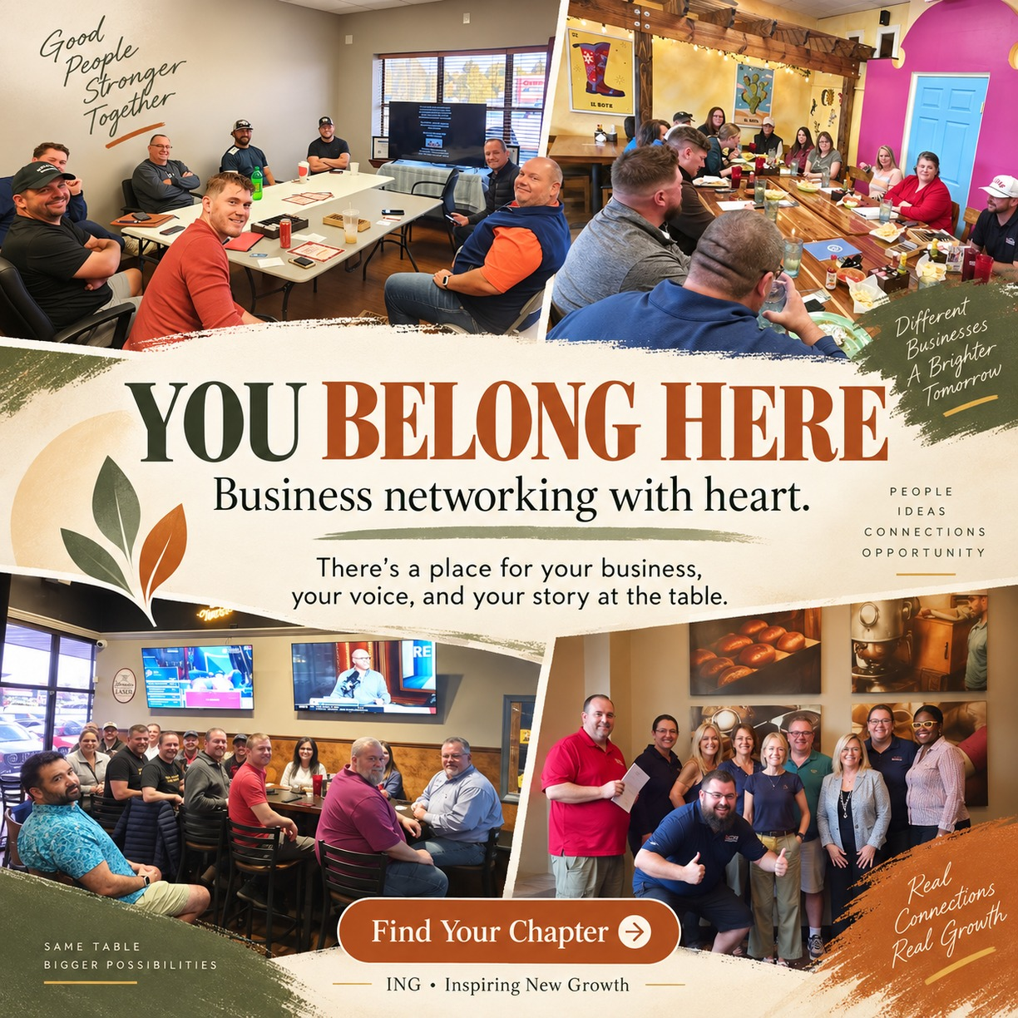
CREATIVE ANGLE 2
You Belong Here
Strong emotional angle for people looking for community and genuine relationships.
Why it works
Addresses the emotional reason people join groups.
Shows several chapter personalities at once.
Good retargeting creative after someone visits the site.
Use real member photography whenever possible. That authenticity is the campaign’s advantage.
ING • Campaign creative example

Slide 8

CREATIVE ANGLE 3
Pull Up a Chair
Benefit-led angle: referrals, accountability, support and community.
Why it works
Makes the business value explicit.
Works well for owners who need a practical reason to try ING.
Good second or third creative in the rotation.
Use real member photography whenever possible. That authenticity is the campaign’s advantage.
ING • Campaign creative example

Slide 9
90-DAY PILOT
What we learn before we spend more
The first $300 is a test designed to tell us where growth is cheapest and most repeatable.
MONTH 1
MONTH 2
MONTH 3
SPRINGFIELD METRO
BRANSON / TRI-LAKES
ROGERSVILLE / EAST
Launch 3 creatives.
Establish baseline cost per visit request.
Use same framework.
Compare geography and creative response.
Test smaller market.
Then reallocate future budget to winners.
At 30 / 60 / 90 days, answer four questions:
Which photo/message gets qualified people to the page?
Which market produces the cheapest guest requests?
How many requests actually attend a chapter?
How many attended guests become members?
No promises about clicks or leads before we have real ING data. The campaign earns the right to scale.
ING • There’s a Seat at the Table • Proposal

Slide 10
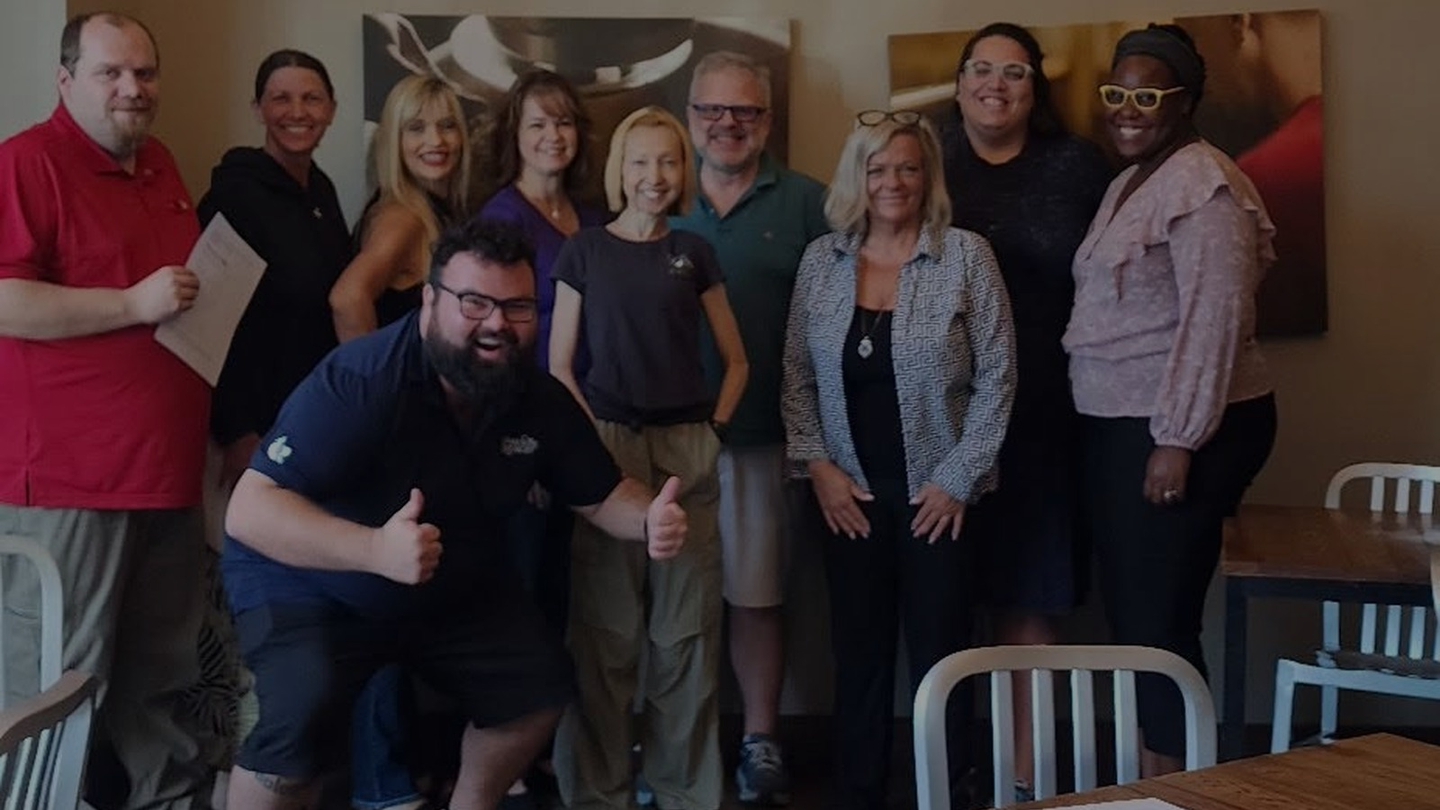
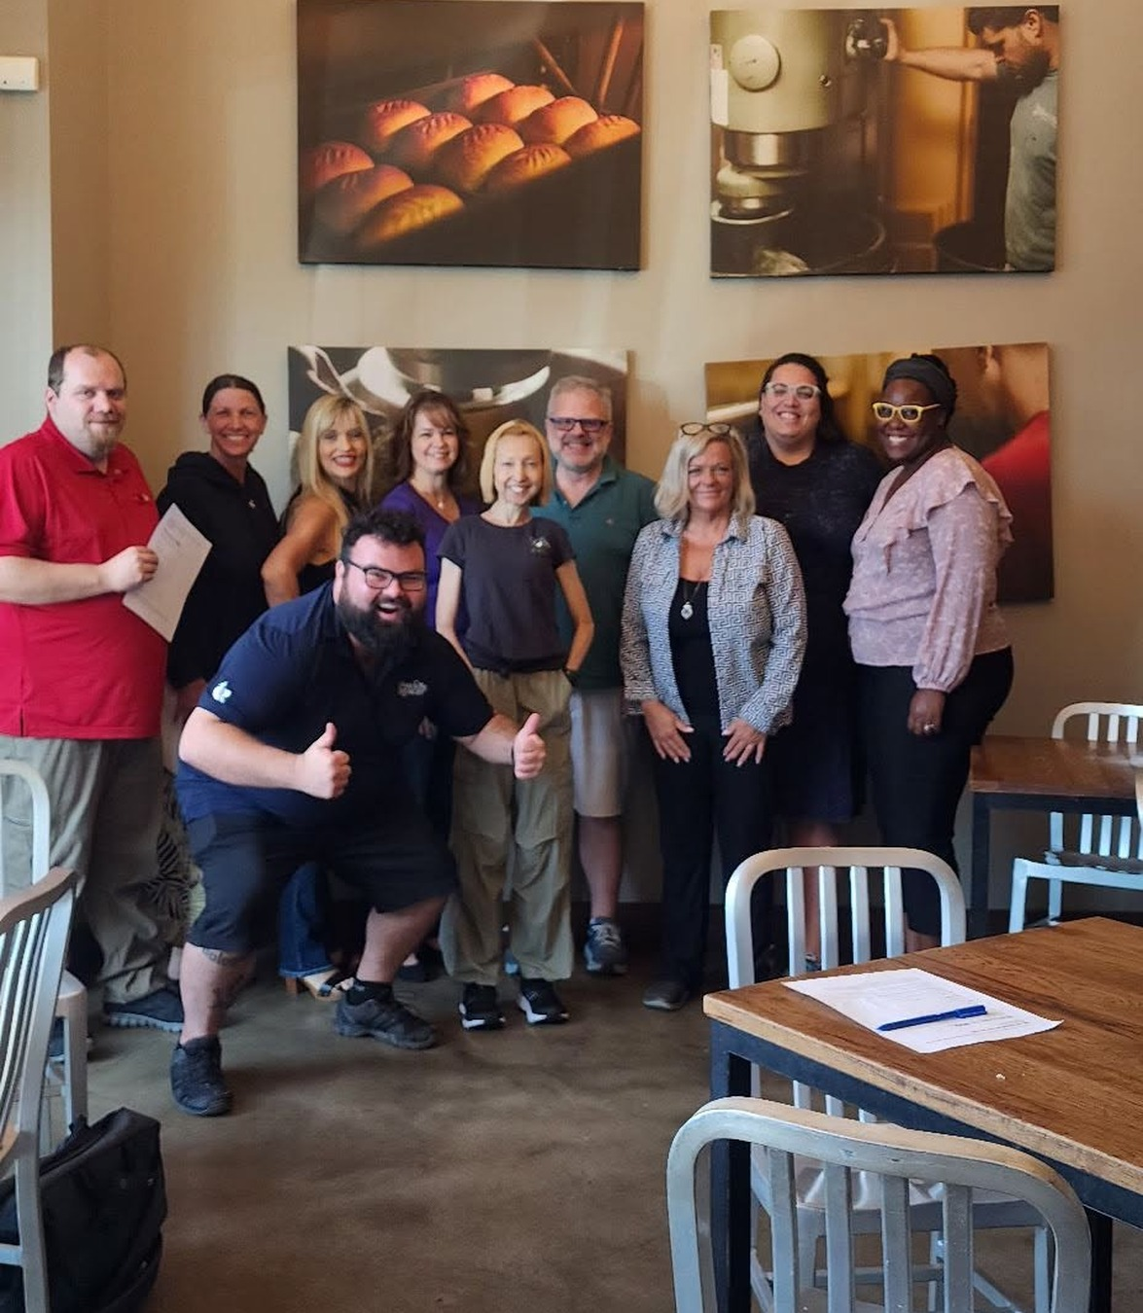
RECOMMENDATION
Approve the
90-day pilot.
$100/month Meta media budget
$12/month contribution from each chapter
Dedicated “There’s a Seat at the Table” landing page
Real-member creative rotation
GA4 + UTM measurement from ad to member
30 / 60 / 90-day optimization reviews
We are not buying impressions.
We are buying introductions.
ING • There’s a Seat at the Table • Recommendation

Slide 11
On Android with Chrome:
Open the page.
Tap the three dots.
Choose Add to home screen.
Choose Create shortcut and tap Add.
Edge can do similar things, although the exact menu wording varies by phone/version. Edge mobile also lets you set a specific webpage as its browser home page.

